Slide 1
ELEVATE LABS Internship Day 2: Superstore Data Analysis with Tableau
NAZIM ATAKAN ERDOGAN

Slide 2
AGENDA
Data exploration and preparation
Sales by region
Monthly sales trend
Sales by product category
Profit by state
Sales vs profit
Customer segment analysis
Customer statistics
Insights

Slide 3
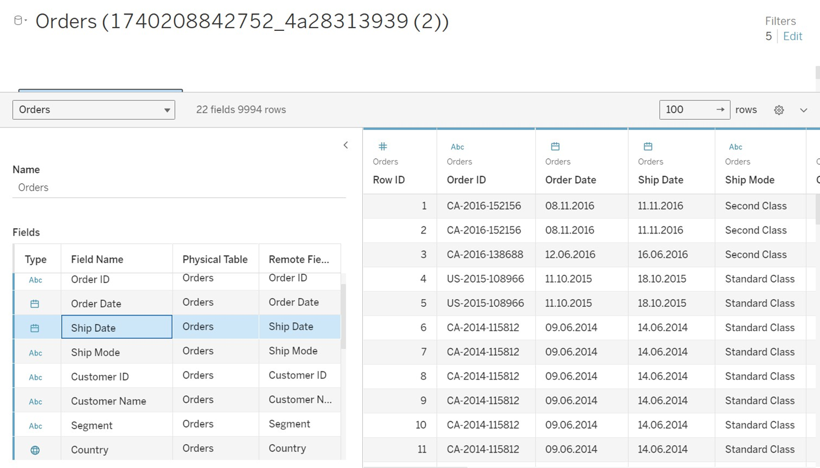
DATASET

Slide 4
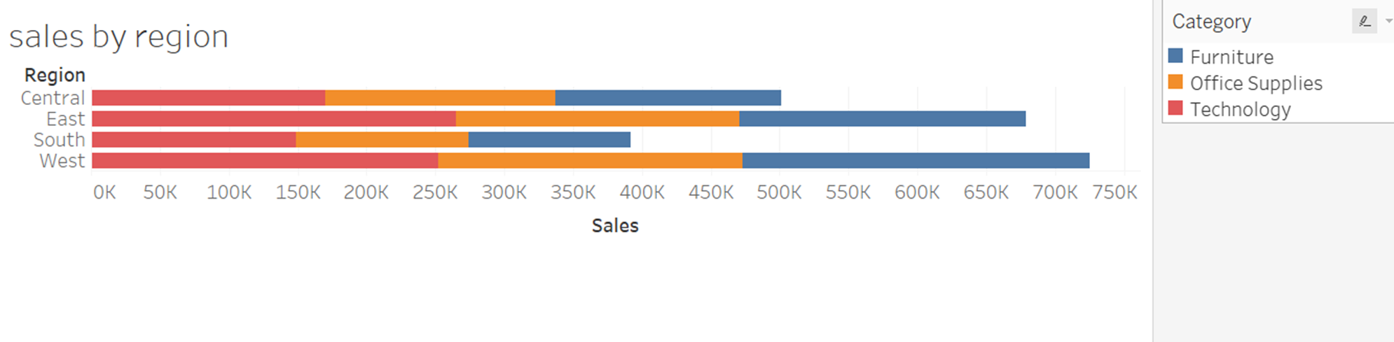
SALES BY REGION

Slide 5
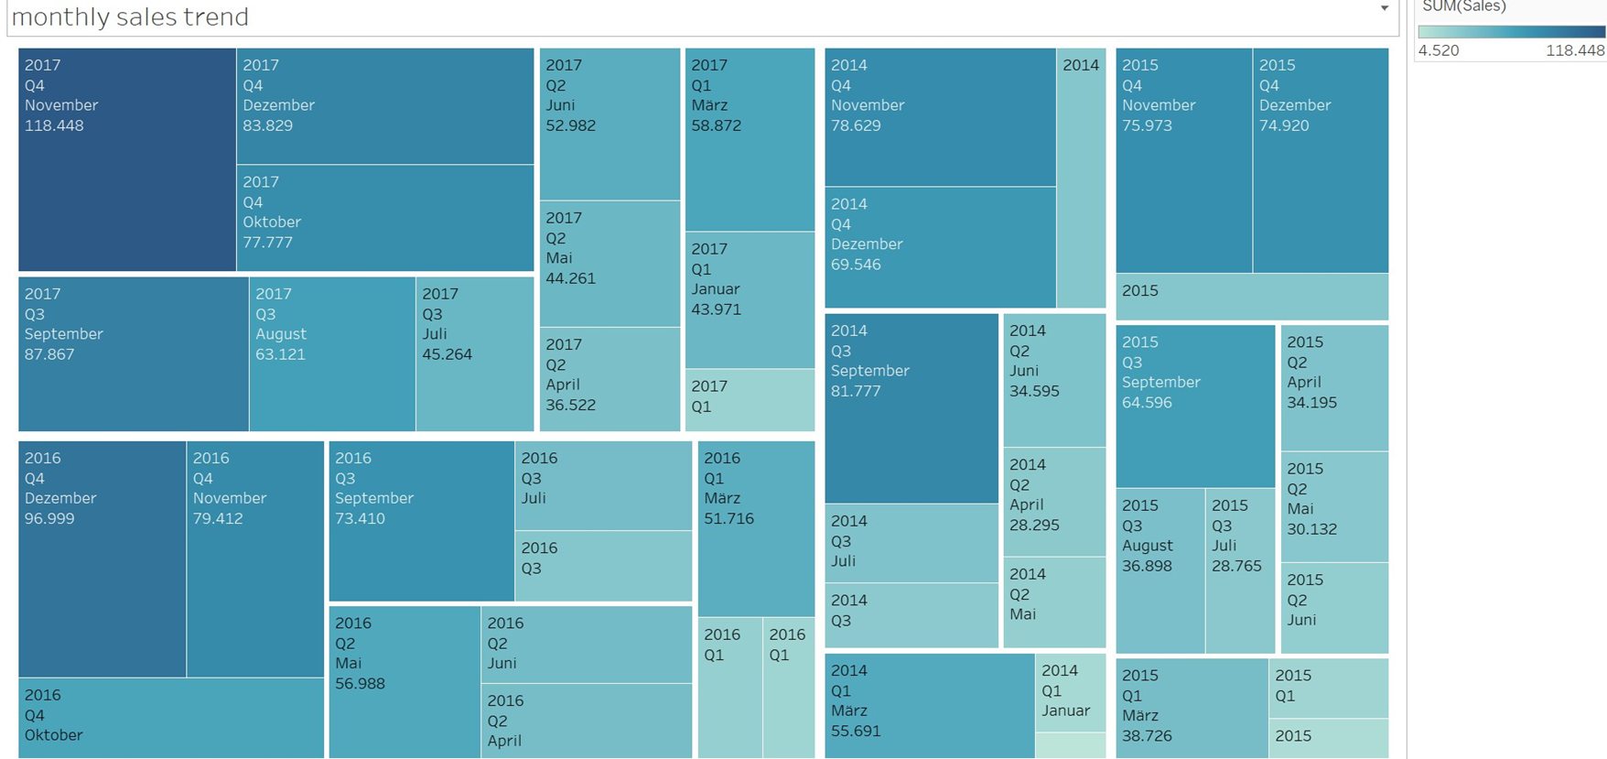
Monthly sales trend

Slide 6
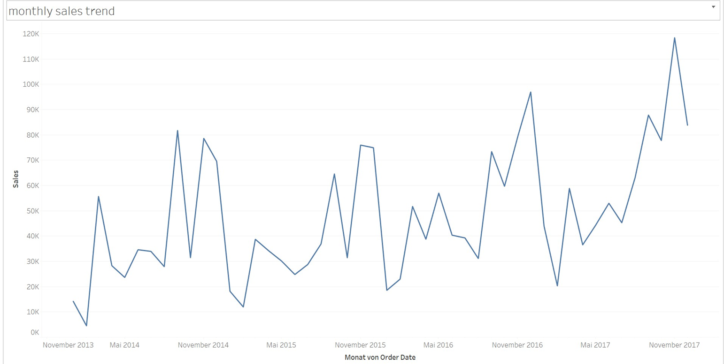
MONTHLY SALES TREND

Slide 7
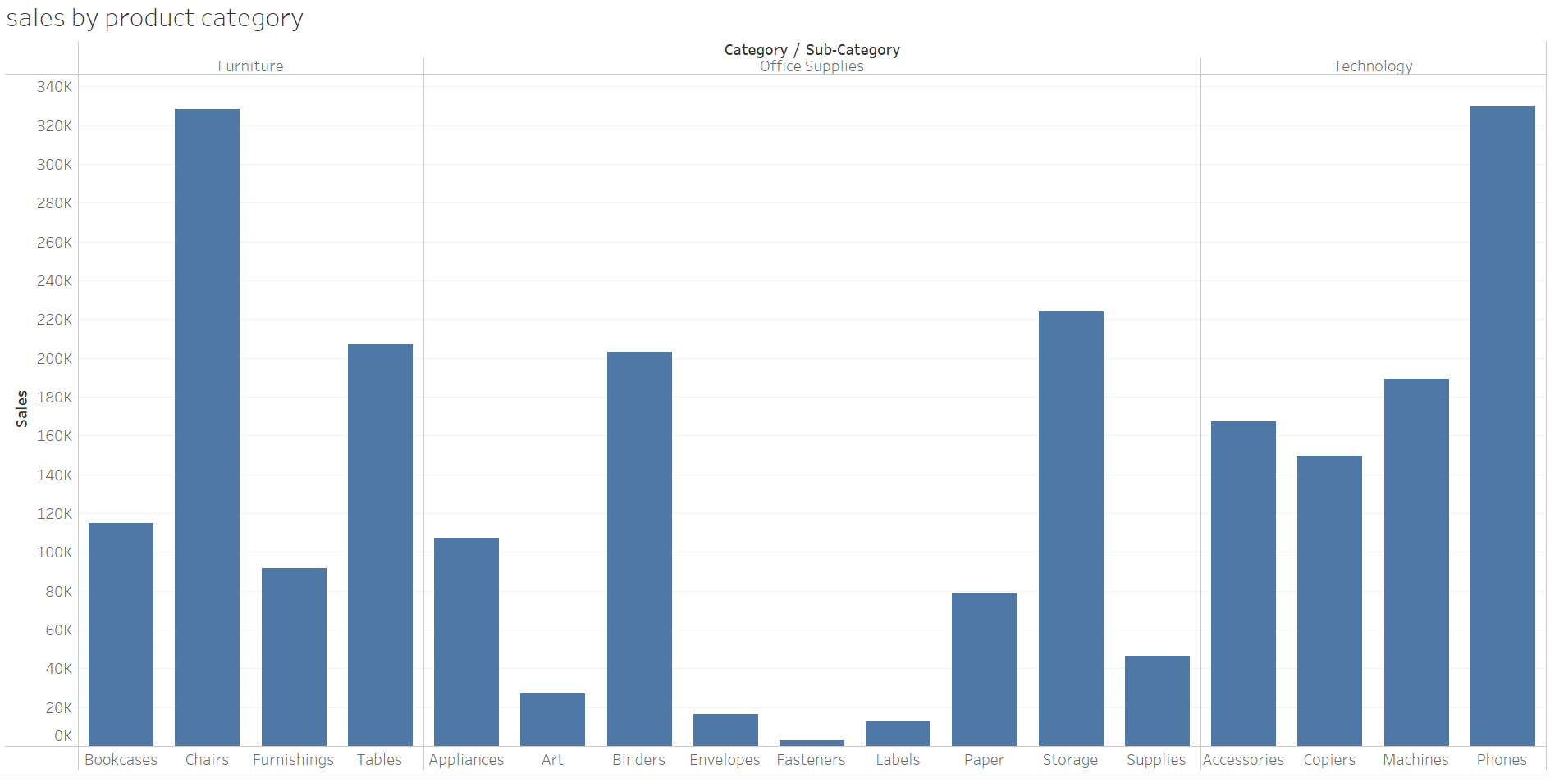
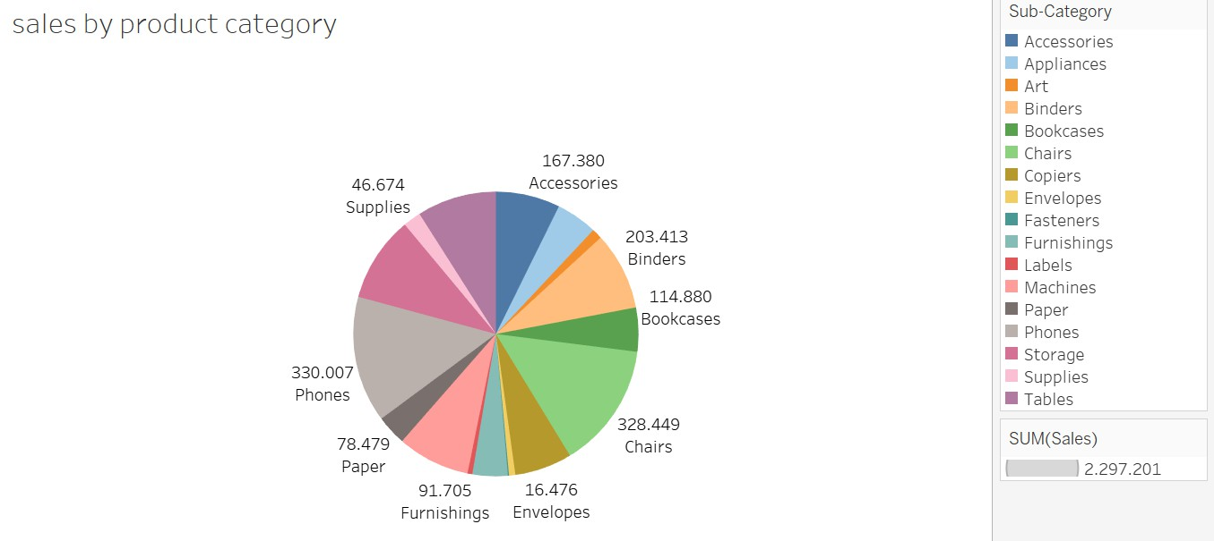
SALES BY PRODUCT CATEGORY

Slide 8


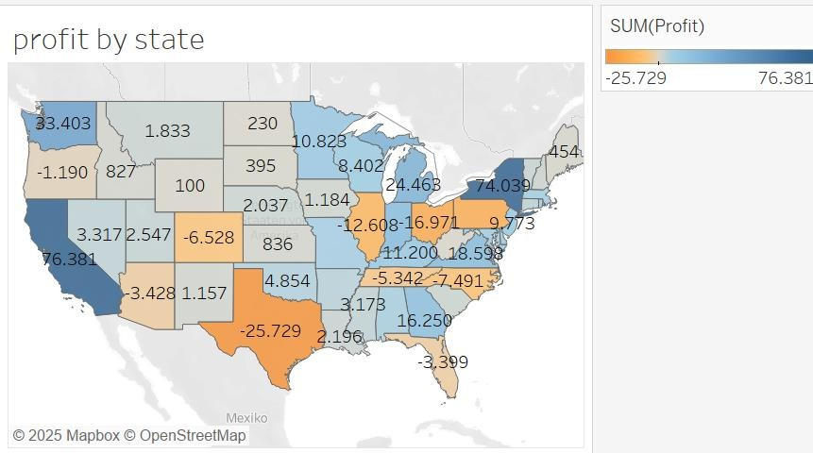
PROFIT BY STATE
Orange = loss

Slide 9


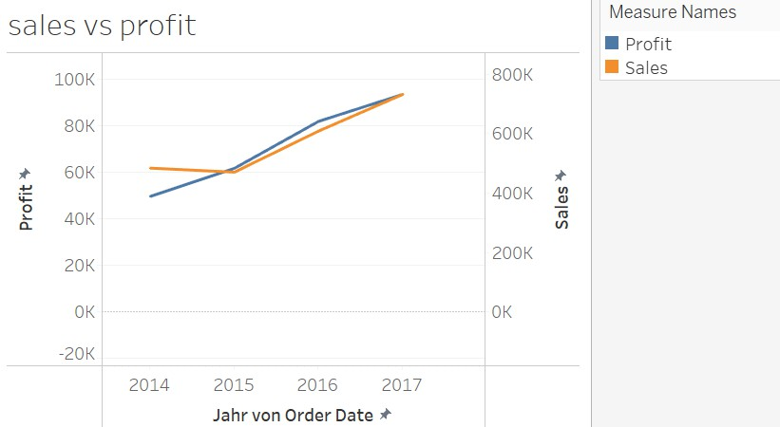
SALES VS PROFIT

Slide 10
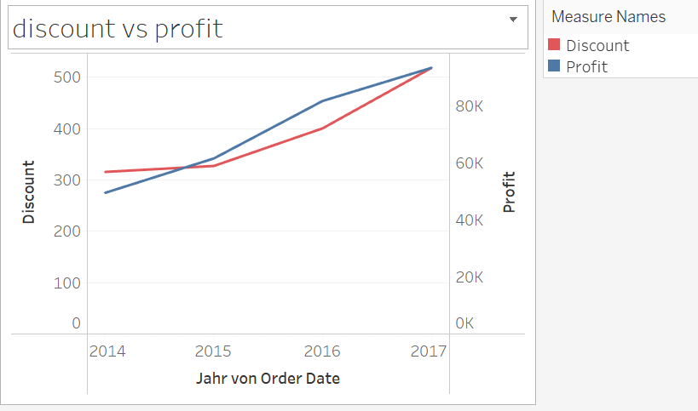
DISCOUNT VS PROFIT

Slide 11
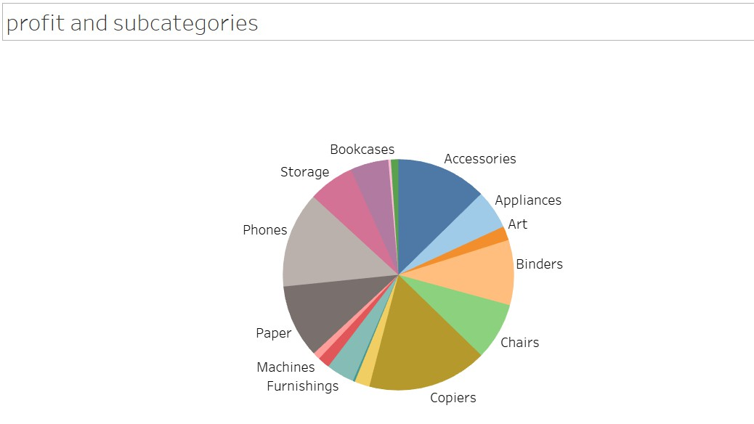
PROFIT AND SUBCATEGORIES

Slide 12
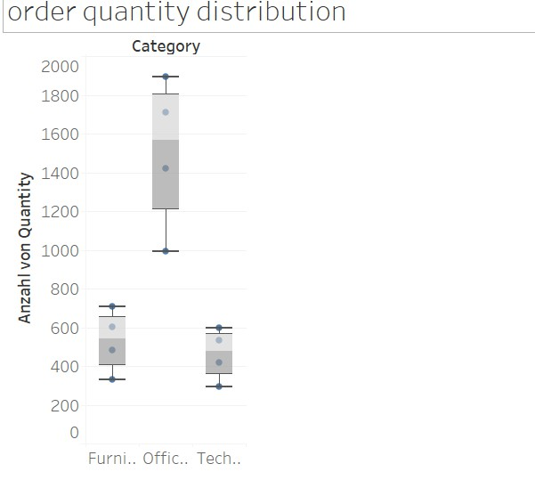
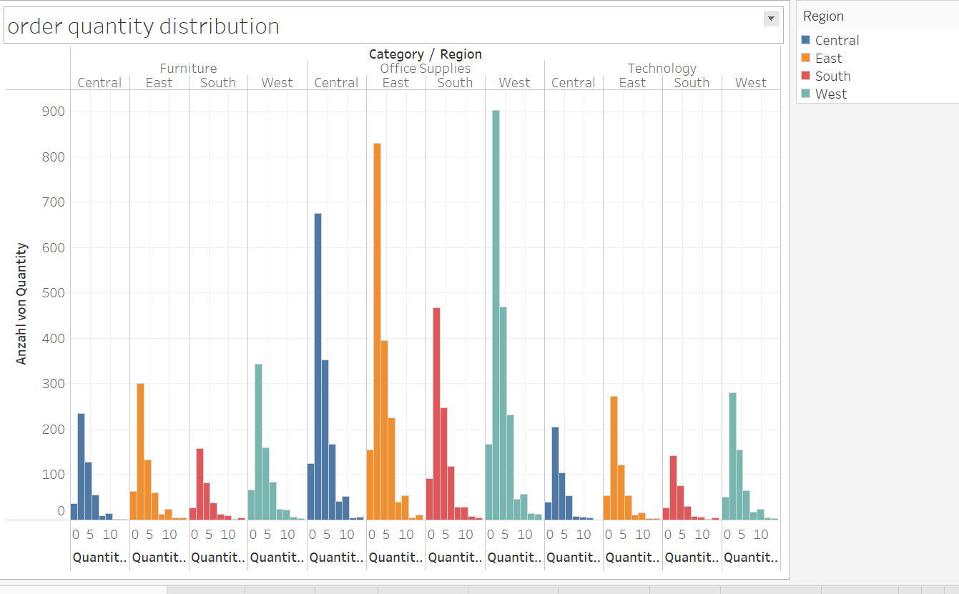
ORDER QUANTITY DISTRIBUTION

Slide 13
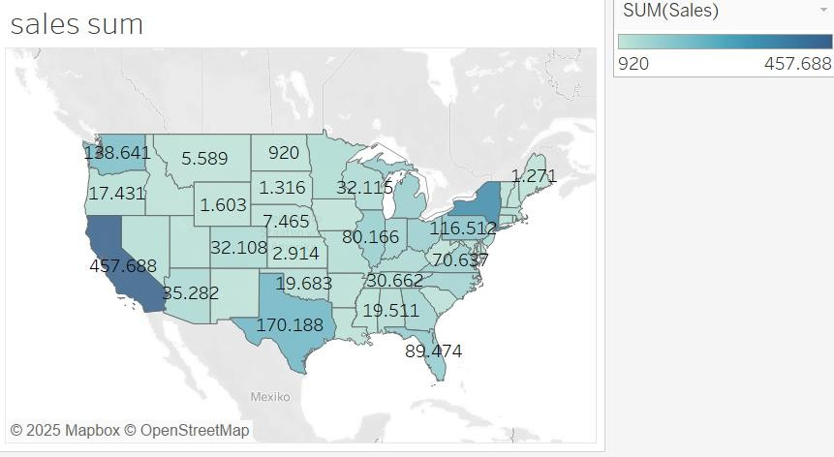
SALES SUM BY STATE

Slide 14
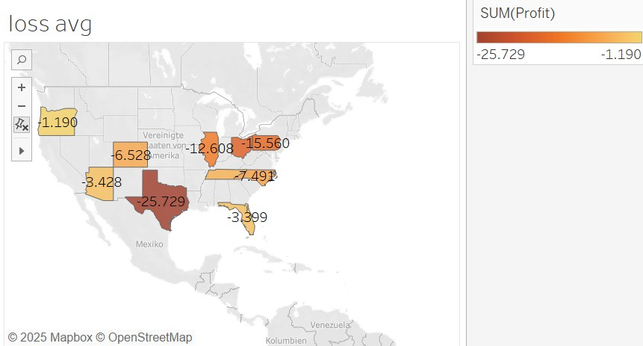
AVERAGE LOSS BY STATE

Slide 15
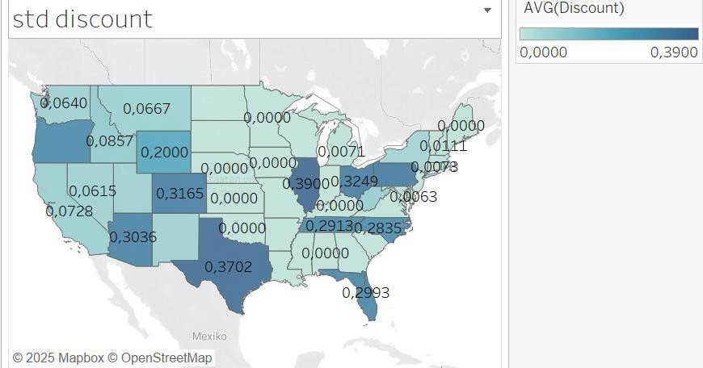
STANDART DEVIATION OF DISCOUNT

Slide 16
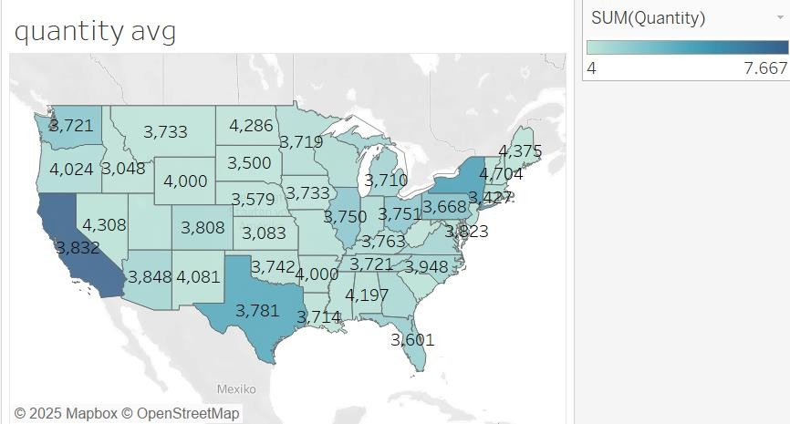
QUANTITY AVERAGE

Slide 17
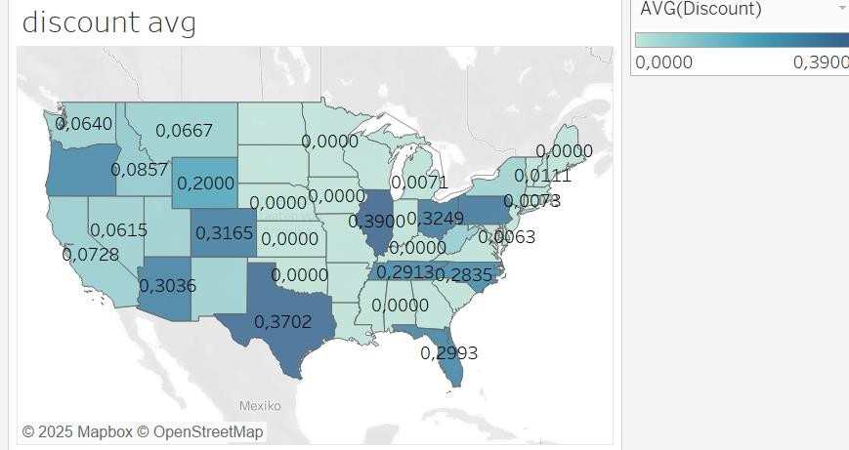
DISCOUNT AVERAGE

Slide 18
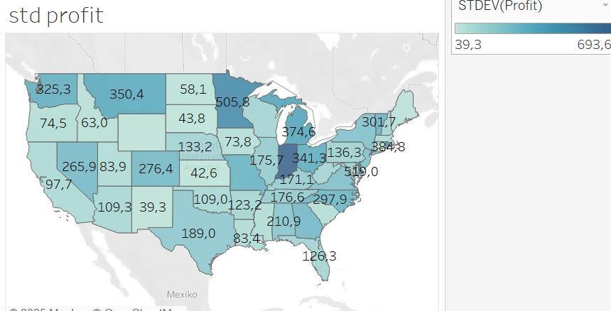
Standard Deviation of Profit

Slide 19
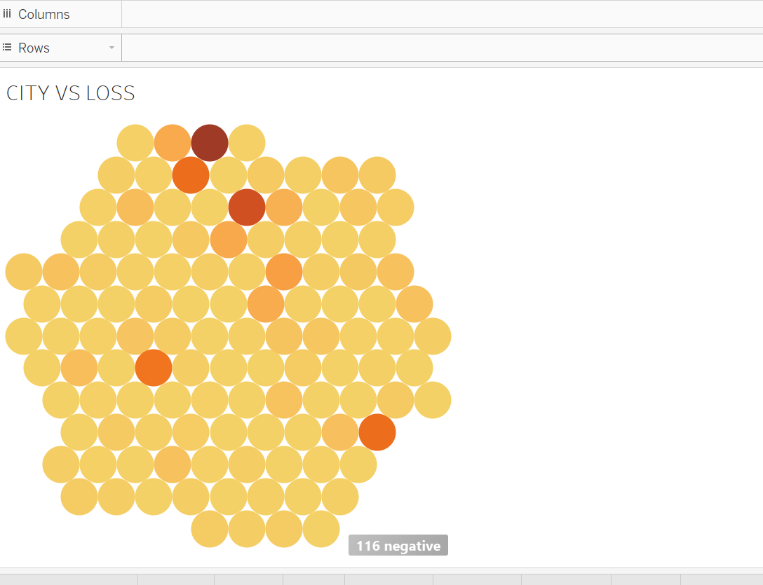
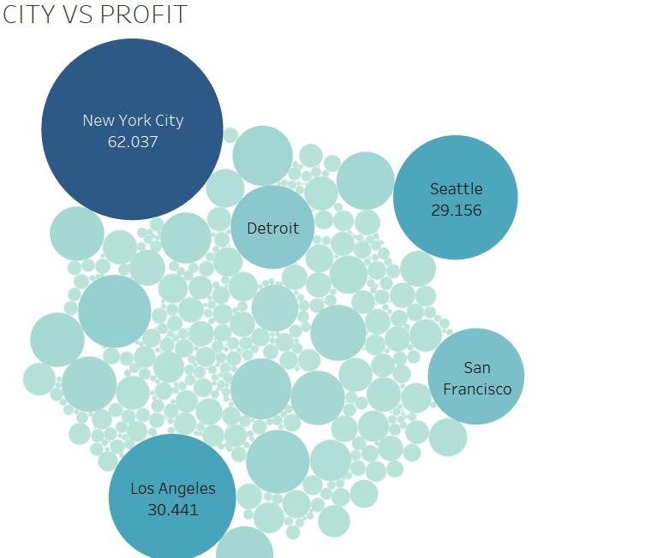
CITY VS LOSS AND PROFIT

Slide 20
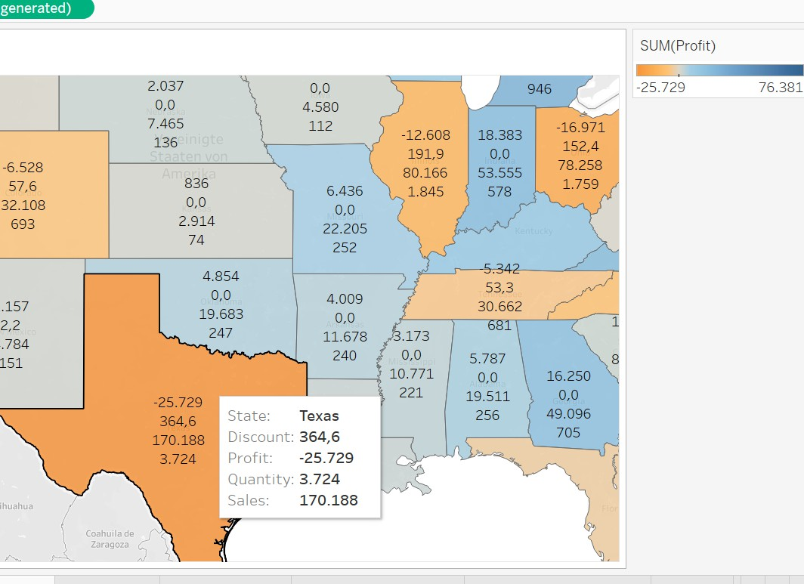
Texas is among the states with the least profit, and the highest loss. It can be seen a huge amount of total discount and the sales rate is high, and though we see such a big loss. Same is valid for Illinois and Pennsylvania.
But as it will be shown later, in category level, the profit in technology is high in Texas. m
Μ

Slide 21
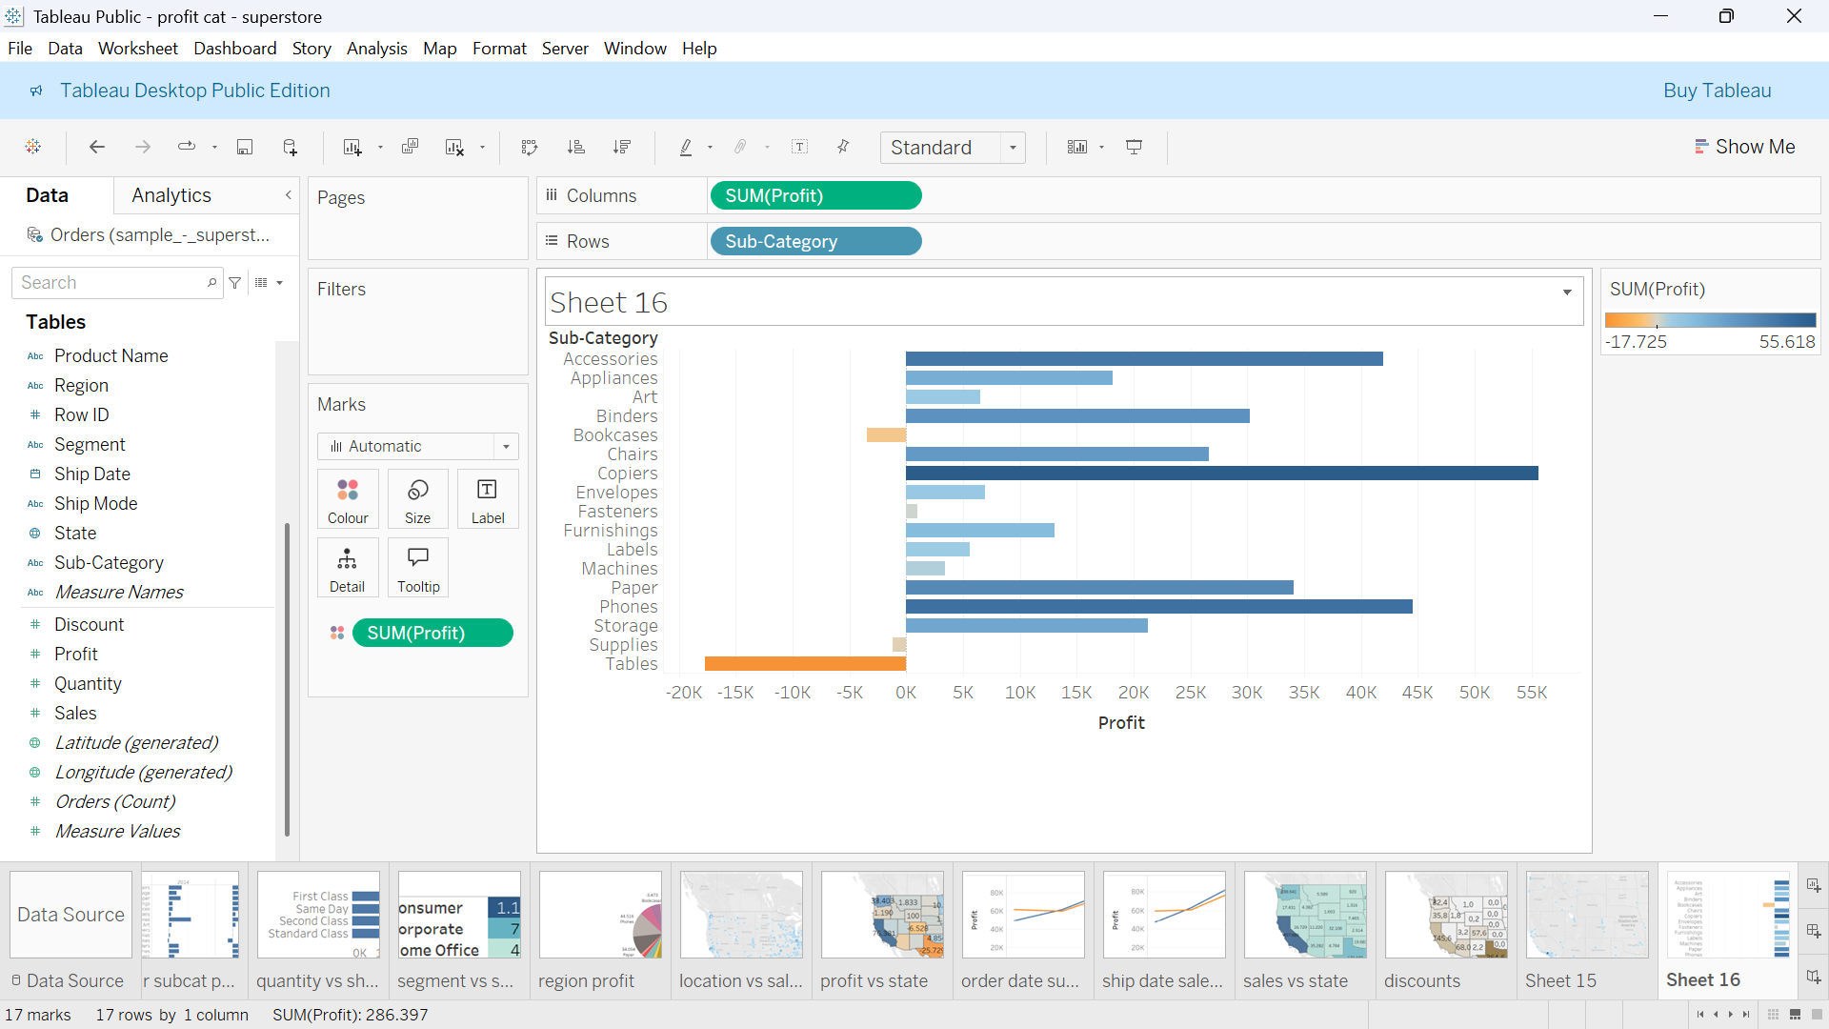
Subcategory vs profit

Slide 22
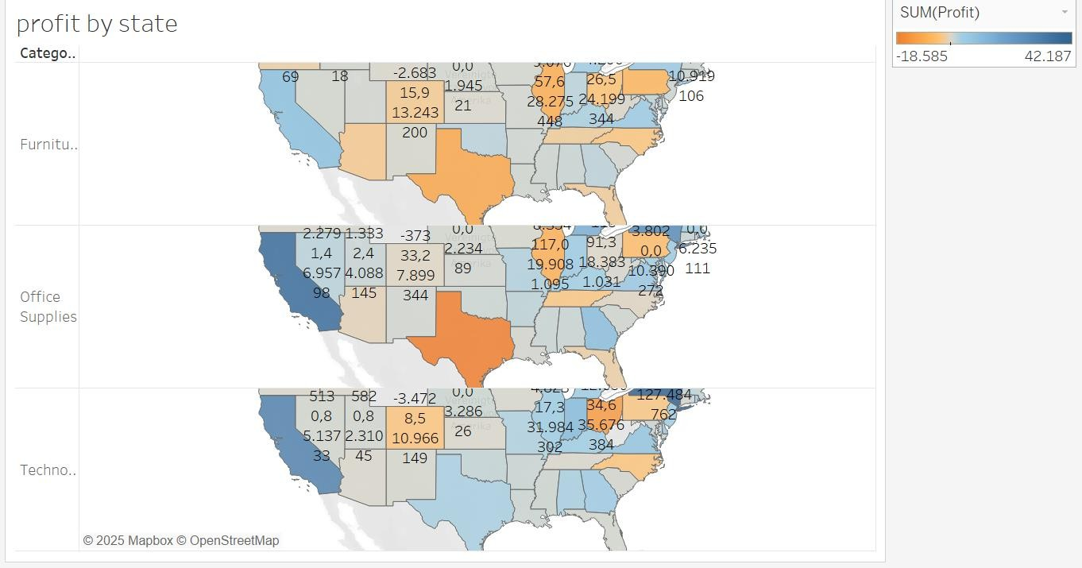

Slide 23
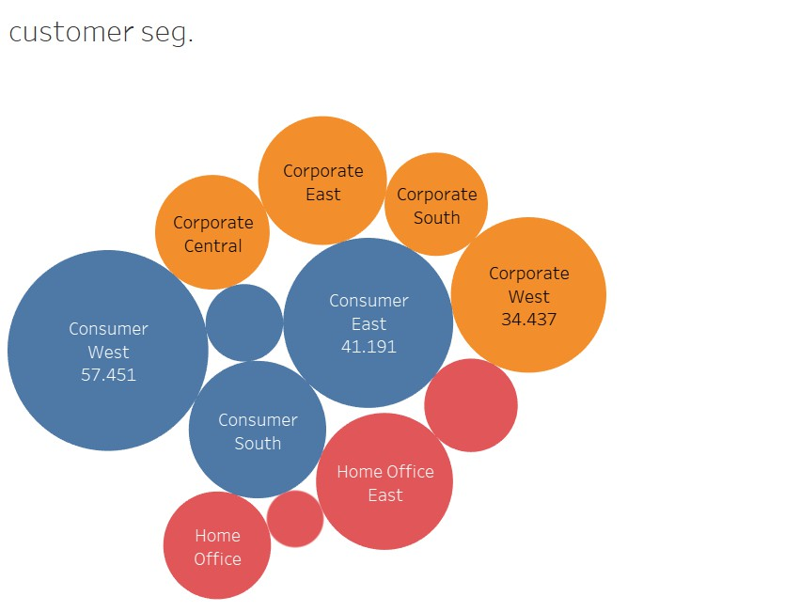
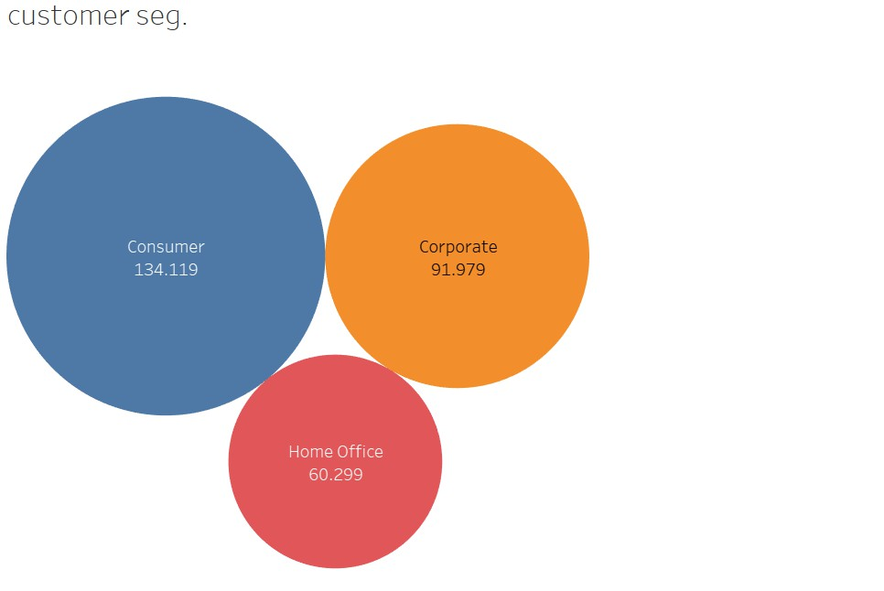
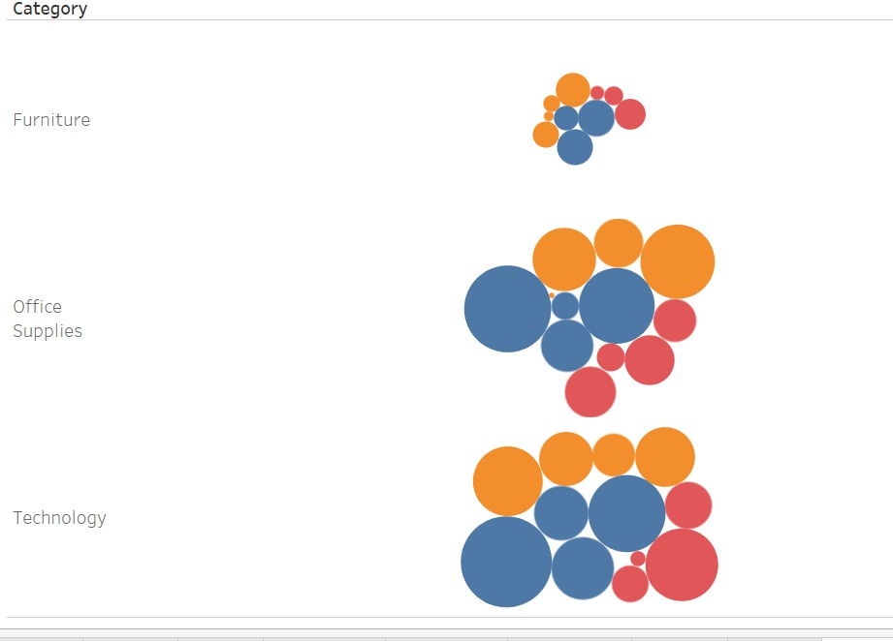
SEGMENT ANALYSIS
CUSTOMER SEGMENTATION

Slide 24
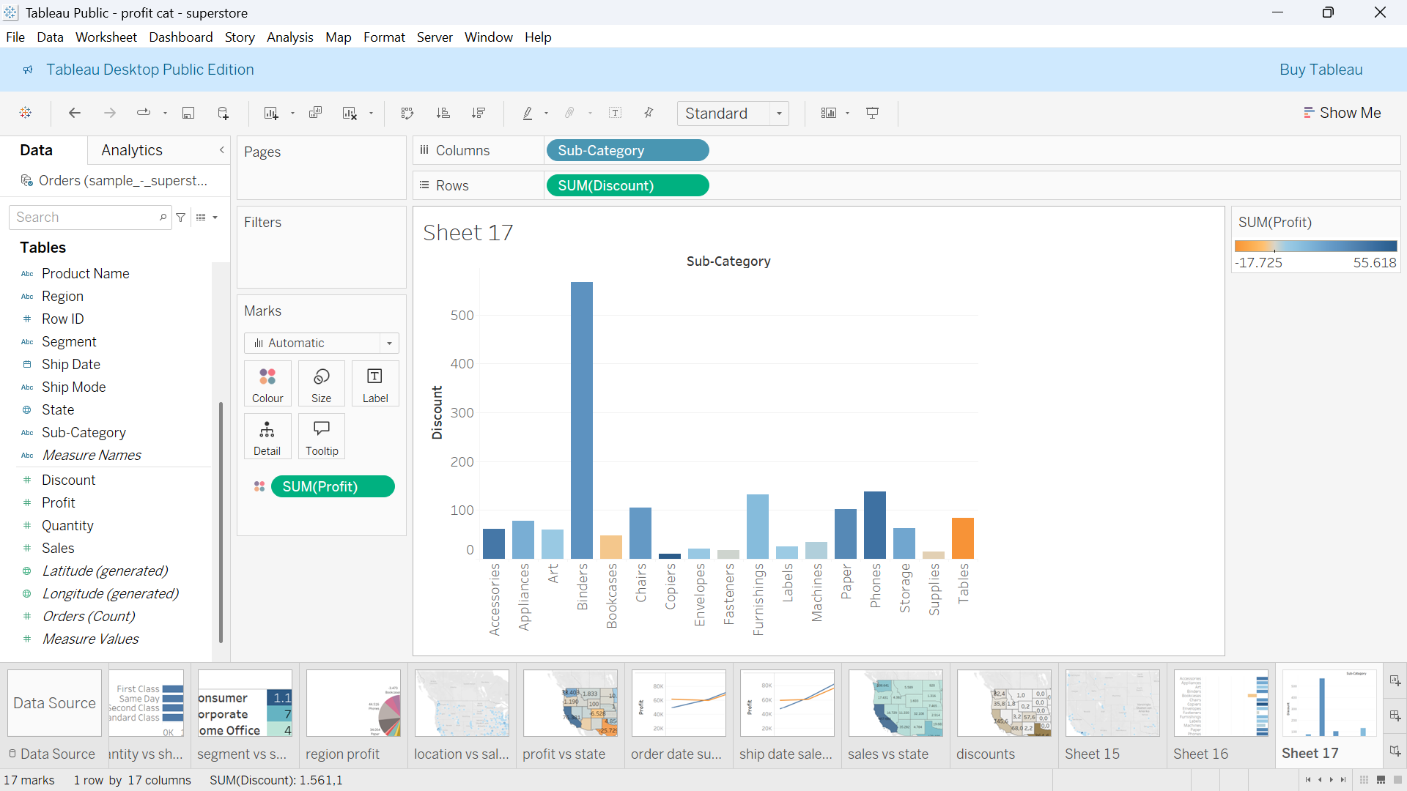
Subcategory and Discount

Slide 25
Regional Sales Overview: Sales are notably high in the West and East regions, while there is a noticeable decrease in the South and Central regions.
Category Insights:
Phones have the highest total sales.
Copiers generate the highest profits.
Bookcases and Tables show the lowest profits, sometimes even resulting in losses.
Binders have the highest average discounts and maintain moderate profits.
State-Level fitability:
The most profitable state is California.
The least profitable state is Texas.
Texas, North Carolina, Arizona, Illinois, and Pennsylvania are the states with the highest losses.
Impact of Discounts and Quantity:
High sales do not always equate to high profits.
Discounts and quantities sold significantly impact profitability.
Higher discounts often lead to greater losses, although they can also boost sales volume.
States like Texas, Pennsylvania, and Illinois show high discount rates and correspondingly high negative profit rates.
Conclusion: Profitability is influenced by a combination of factors, including product category, regional performance, discount strategy, and sales volume. Strategic discounting and targeted sales efforts are crucial for maximizing profit.

Slide 26





Slide 27
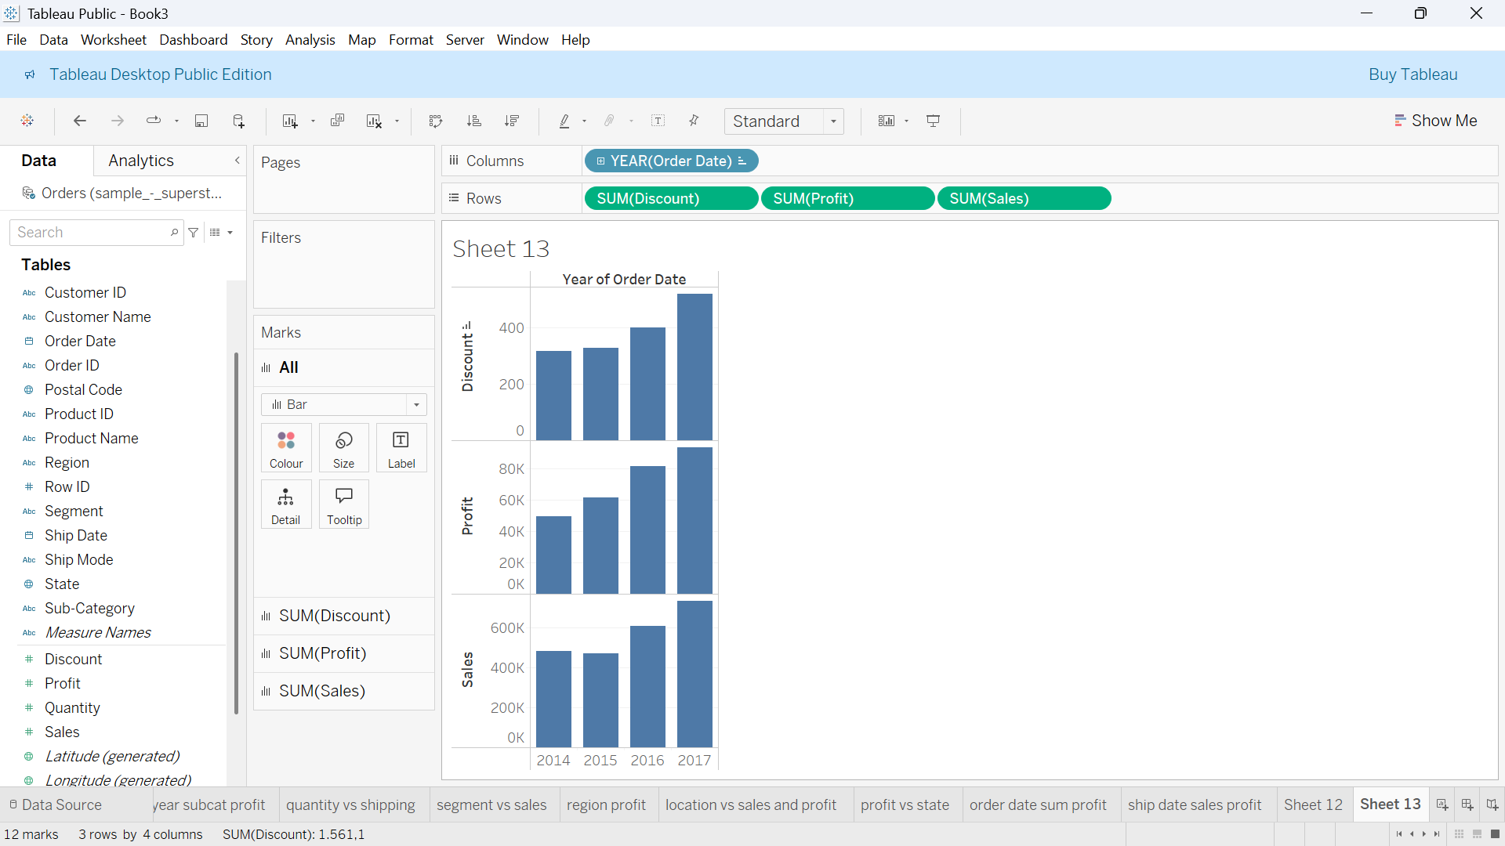



Slide 28
THANK YOU
N A Z I M ATA K A N E R D O G A N

